Slide 1
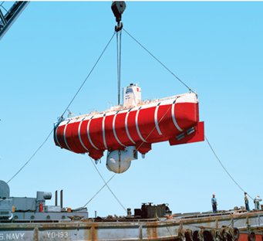
EQUILIBRIUM OF A RIGID BODY & FREE-BODY DIAGRAMS
Today’s Objectives:
Students will be able to:
a) Identify support reactions, and,
b) Draw a free-body diagram.
In-Class Activities:
Check Homework
Reading Quiz
Applications
Support Reactions
Free-Body Diagrams
Concept Quiz
Group Problem Solving
Attention Quiz

Slide 2
READING QUIZ
1. If a support prevents translation of a body, then the support exerts a ___________ on the body.
A) Couple moment
B) Force
C) Both A and B.
D) None of the above
2. Internal forces are _________ shown on the free body diagram of a whole body.
A) Always
B) Often
C) Rarely
D) Never
Notes:
Answers:
1. B
2. D

Slide 3
APPLICATIONS
The truck ramps have a weight of 400 lb each.
Each ramp is pinned to the body of the truck and held in the position by a cable. How can we determine the cable tension and support reactions?
How are the idealized model and the free body diagram used to do this?
Which diagram above is the idealized model?

Slide 4
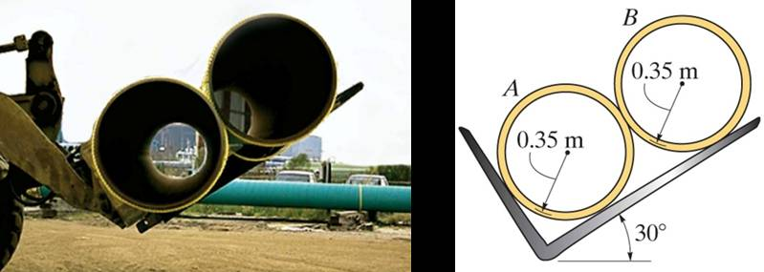
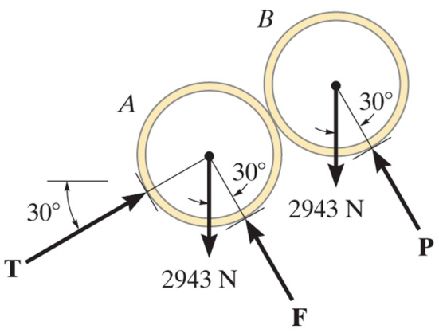
APPLICATIONS (continued)
Two smooth pipes, each having a mass of 300 kg, are supported by the tines of the tractor fork attachment.
How can we determine all the reactive forces?
Again, how can we make use of an idealized model and a free body diagram to answer this question?

Slide 5
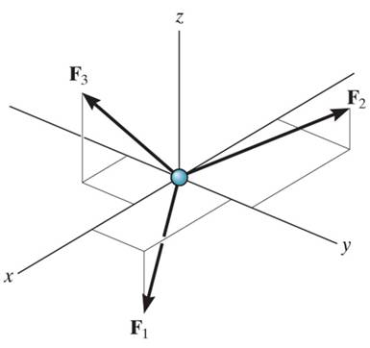
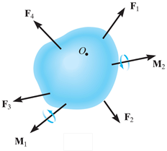
CONDITIONS FOR RIGID-BODY EQUILIBRIUM
(Section 5.1)
In contrast to the forces on a particle, the forces on a rigid-body are not usually concurrent and may cause rotation of the body (due to the moments created by the forces).
Forces on a particle
For a rigid body to be in equilibrium, the net force as well as the net moment about any arbitrary point O must be equal to zero.
∑ F = 0 (no translation)
and ∑ M_{O} = 0 (no rotation)
Forces on a rigid body

Slide 6
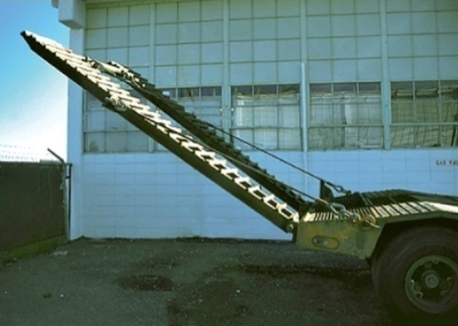
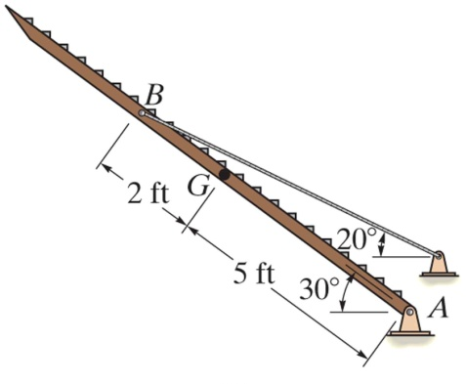
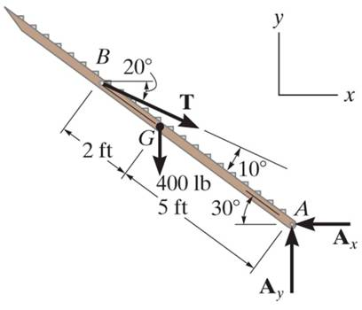
THE PROCESS OF SOLVING RIGID BODY EQUILIBRIUM PROBLEMS
For analyzing an actual physical system, first we need to create an idealized model (above right).
Then we need to draw a free-body diagram (FBD) showing all the external (active and reactive) forces.
Finally, we need to apply the equations of equilibrium to solve for any unknowns.

Slide 7
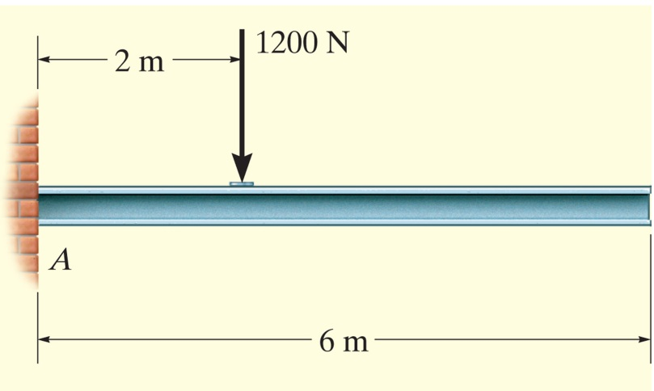
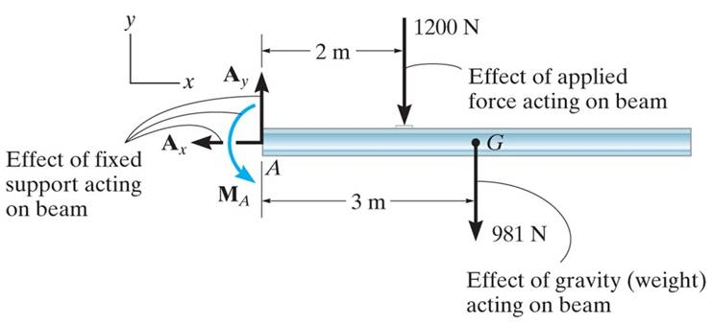
FREE-BODY DIAGRAMS (Section 5.2)
Idealized model
Free-body diagram (FBD)
1. Draw an outlined shape. Imagine the body to be isolated or cut “free” from its constraints and draw its outlined shape.
2. Show all the external forces and couple moments. These typically include: a) applied loads, b) support reactions, and, c) the weight of the body.

Slide 8
FREE-BODY DIAGRAMS (continued)
Idealized model
Free-body diagram
3. Label loads and dimensions on the FBD: All known forces and couple moments should be labeled with their magnitudes and directions. For the unknown forces and couple moments, use letters like A_{x}, A_{y}, M_{A}. Indicate any necessary dimensions.

Slide 9
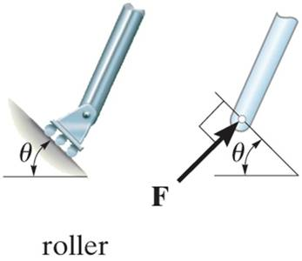
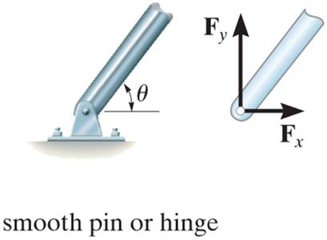
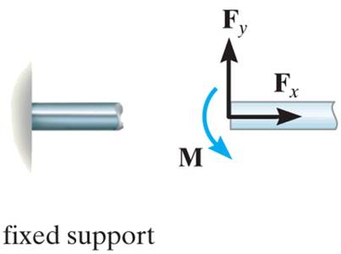
SUPPORT REACTIONS IN 2-D
A few example sets of diagrams s are shown above. Other support reactions are given in your textbook (Table 5-1).
As a general rule, if a support prevents translation of a body in a given direction, then a force is developed on the body in the opposite direction.
Similarly, if rotation is prevented, a couple moment is exerted on the body in the opposite direction.

Slide 10
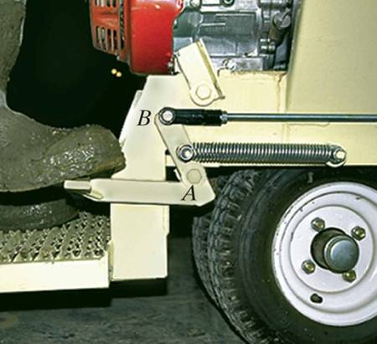
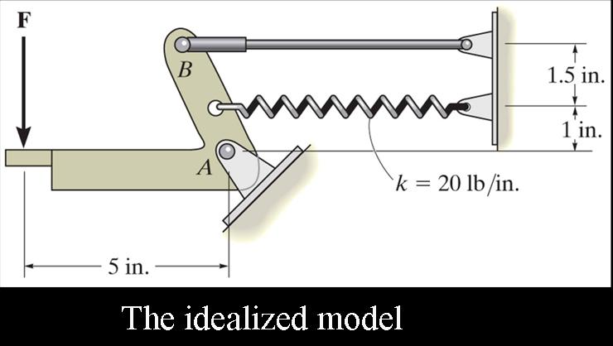
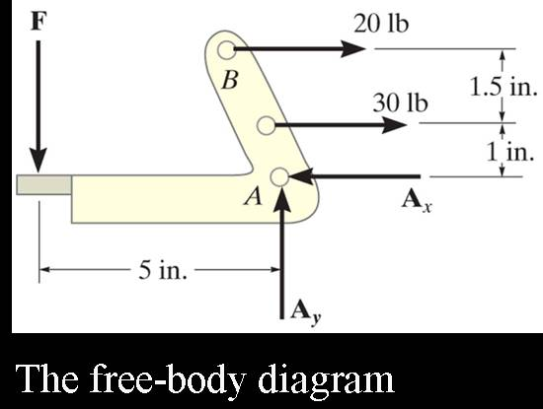
EXAMPLE
Given: The operator applies a vertical force to the pedal so that the spring is stretched 1.5 in. and the force in the short link at B is
20 lb.
Draw: A an idealized model and free- body diagram of the foot pedal.

Slide 11
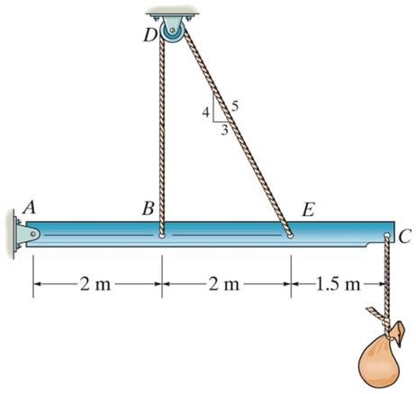
CONCEPT QUIZ
1. The beam and the cable (with a frictionless pulley at D) support an 80 kg load at C. In a FBD of only the beam, there are how many unknowns?
A) 2 forces and 1 couple moment
B) 3 forces and 1 couple moment
C) 3 forces
D) 4 forces
Notes:
Answers :
1. C

Slide 12
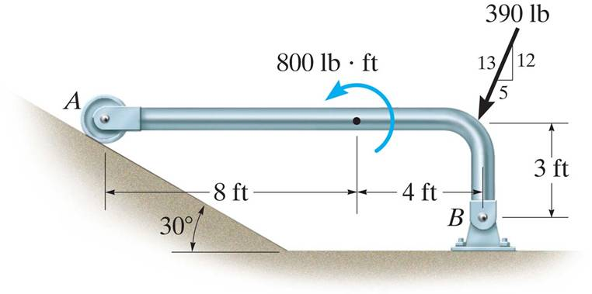
CONCEPT QUIZ (continued)
2. If the directions of the force and the couple moments are both reversed, what will happen to the beam?
A) The beam will lift from A. B) The beam will lift at B. C) The beam will be restrained.
D) The beam will break.
Notes:
Answer
2. A

Slide 13
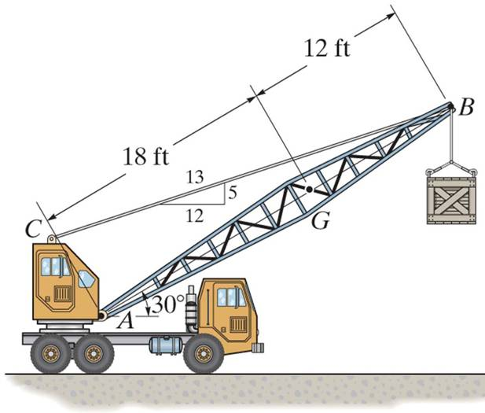
GROUP PROBLEM SOLVING
Given:
Draw:
A FBD of the crane boom, which is supported by a pin at A and cable BC. The load of 1250 lb is suspended at B and the boom weighs 650 lb.

Slide 14
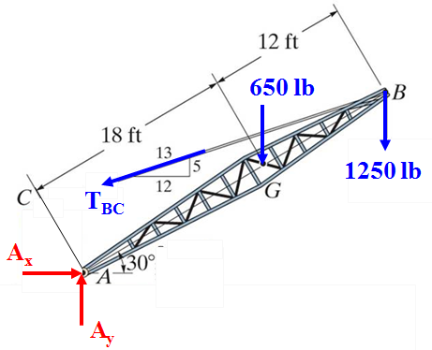
GROUP PROBLEM SOLVING (continued)
FBD
Idealized model

Slide 15
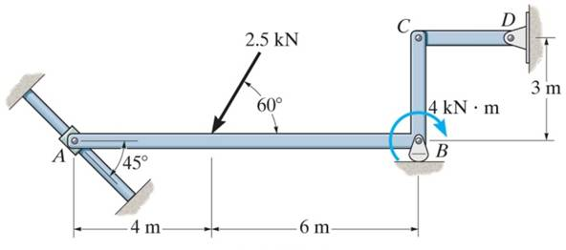
GROUP PROBLEM SOLVING (continued)
Given:
Draw:
Draw a FBD of member ABC, which is supported by a smooth collar at A, roller at B, and link CD.

Slide 16
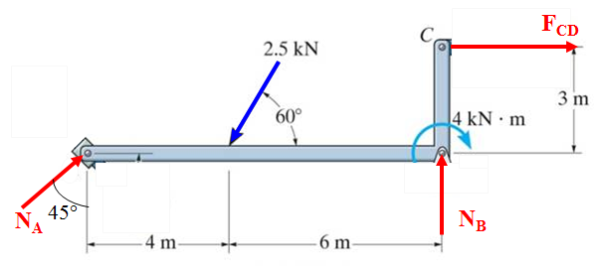
GROUP PROBLEM SOLVING (continued)
Idealized model
FBD

Slide 17
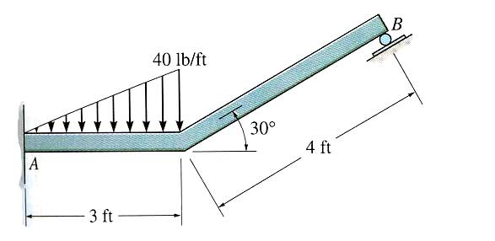
ATTENTION QUIZ
1. Internal forces are not shown on a free-body diagram because the internal forces are _____. (Choose the most appropriate answer.)
A) Equal to zero B) Equal and opposite and they do not affect the calculations
C) Negligibly small D) Not important
2. How many unknown support reactions are there in this problem?
A) 2 forces and 2 couple moments
B) 1 force and 2 couple moments
C) 3 forces
D) 3 forces and 1 couple moment
Notes:
Answers:
1.B
2.D

Slide 18
End of the Lecture
Let Learning Continue

