Slide 1
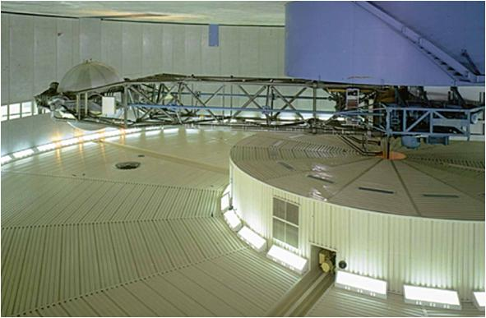
EQUATIONS OF MOTION: NORMAL AND TANGENTIAL COORDINATES
Today’s Objectives:
Students will be able to:
Apply the equation of motion using normal and tangential coordinates.
In-Class Activities:
Check Homework
Reading Quiz
Applications
Equation of Motion using n-t Coordinates
Concept Quiz
Group Problem Solving
Attention Quiz

Slide 2
READING QUIZ
1. The “normal” component of the equation of motion is written as ΣF_{n}=ma_{n}, where ΣF_{n} is referred to as the _______.
A) impulse B) centripetal force
C) tangential force D) inertia force
2. The positive n direction of the normal and tangential coordinates is ____________.
A) normal to the tangential component
B) always directed toward the center of curvature
C) normal to the bi-normal component
D) All of the above.
Notes:
Answers:
1. B
2. D

Slide 3
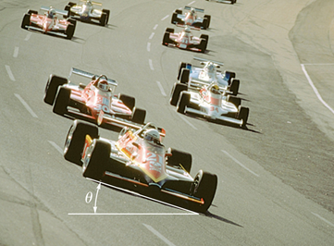
APPLICATIONS
Race track turns are often banked to reduce the frictional forces required to keep the cars from sliding up to the outer rail at high speeds.
If the car’s maximum velocity and a minimum coefficient of friction between the tires and track are specified, how can we determine the minimum banking angle (θ) required to prevent the car from sliding up the track?

Slide 4
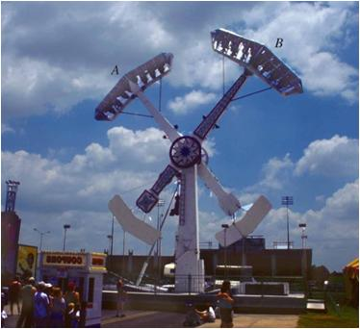
APPLICATIONS (continued)
This picture shows a ride at the amusement park. The hydraulically-powered arms turn at a constant rate, which creates a centrifugal force on the riders.
We need to determine the smallest angular velocity of cars A and B such that the passengers do not lose contact with their seat. What parameters are needed for this calculation?

Slide 5
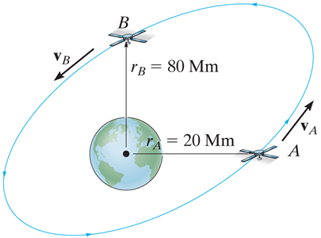
APPLICATIONS (continued)
Satellites are held in orbit around the earth by using the earth’s gravitational pull as the centripetal force – the force acting to change the direction of the satellite’s velocity.
Knowing the radius of orbit of the satellite, we need to determine the required speed of the satellite to maintain this orbit. What equation governs this situation?

Slide 6
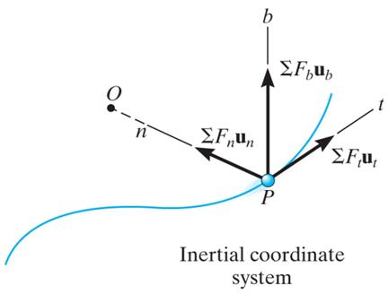
NORMAL & TANGENTIAL COORDINATES (Section 13.5)
When a particle moves along a curved path, it may be more convenient to write the equation of motion in terms of normal and tangential coordinates.
The normal direction (n) always points toward the path’s center of curvature. In a circle, the center of curvature is the center of the circle.
The tangential direction (t) is tangent to the path, usually set as positive in the direction of motion of the particle.

Slide 7
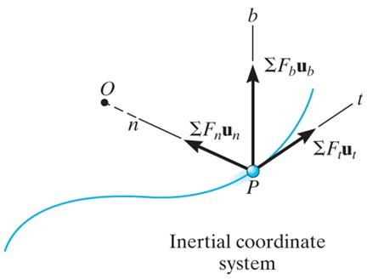
EQUATIONS OF MOTION
Since the equation of motion is a vector equation, ∑F = ma,
it may be written in terms of the n & t coordinates as
∑F_{t}u_{t} + ∑F_{n}u_{n}+ ∑F_{b}u_{b} = ma_{t}+ma_{n}
Here ∑F_{t} & ∑F_{n} are the sums of the force components acting in the t & n directions, respectively.
This vector equation will be satisfied provided the individual components on each side of the equation are equal, resulting in the two scalar equations: ∑F_{t} = ma_{t} and ∑F_{n} = ma_{n} .
Since there is no motion in the binormal (b) direction, we can also write ∑F_{b} = 0.

Slide 8
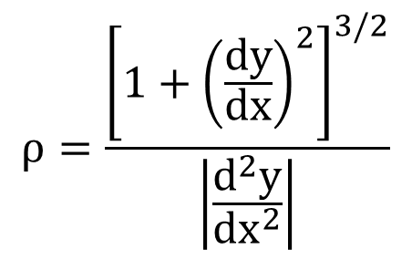
NORMAL AND TANGENTIAL ACCELERATION
The tangential acceleration, a_{t} = dv/dt, represents the time rate of change in the magnitude of the velocity. Depending on the direction of ∑F_{t}, the particle’s speed will either be increasing or decreasing.
The normal acceleration, a_{n} = v²/ρ, represents the time rate of change in the direction of the velocity vector. Remember, a_{n} always acts toward the path’s center of curvature. Thus, ∑F_{n} will always be directed toward the center of the path.
$$ρ=\frac{{\left[1+{\left(\frac{dy}{dx}\right)}^{2}\right]}^{3/2}}{\left|\frac{d^{2}y}{{dx}^{2}}\right|}$$
Recall, if the path of motion is defined as y = f(x), the radius of curvature at any point can be obtained from

Slide 9
SOLVING PROBLEMS WITH n-t COORDINATES
• Use n-t coordinates when a particle is moving along a known, curved path.
• Establish the n-t coordinate system on the particle.
• Draw free-body and kinetic diagrams of the particle. The normal acceleration (a_{n}) always acts “inward” (the positive n-direction). The tangential acceleration (a_{t}) may act in either the positive or negative t direction.
• Apply the equations of motion in scalar form and solve.
• It may be necessary to employ the kinematic relations:
a_{t} = dv/dt = v dv/ds a_{n} = v²/ρ

Slide 10
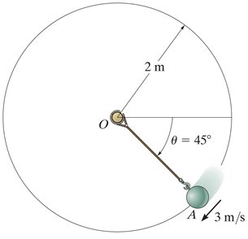
EXAMPLE
Given: The 10-kg ball has a velocity of 3 m/s when it is at A, along the vertical path.
Find: The tension in the cord and the increase in the speed of the ball.
Plan:
1) Since the problem involves a curved path and requires finding the force perpendicular to the path, use n-t coordinates. Draw the ball’s free-body and kinetic diagrams.
2) Apply the equation of motion in the n-t directions.
Notes:
Source : F13-11

Slide 11
EXAMPLE (continued)
Solution:
The n-t coordinate system can be established on the ball at Point A, thus at an angle of 45°. Draw the free-body and kinetic diagrams of the ball.
Free-body diagram
Kinetic diagram
n
W
n
T
ma_{n}
45°
=
t
ma_{t}
t

Slide 12
EXAMPLE (continued)
2) Apply the equations of motion in the n-t directions.
(a) ∑F_{n} = ma_{n} ⇒ T – W sin 45° = m a_{n}
Using a_{n} = v²/ρ = 3²/2, W = 10(9.81) N, and m = 10 kg
T – 98.1 sin 45° = (10) (3²/2)
⇒ T = 114 N
(b) ∑F_{t} = ma_{t} ⇒ W cos 45° = ma_{t}
⇒ 98.1 cos 45° = 10 a_{t}
⇒ a_{t} = (dv/dt) = 6.94 m/s²

Slide 13
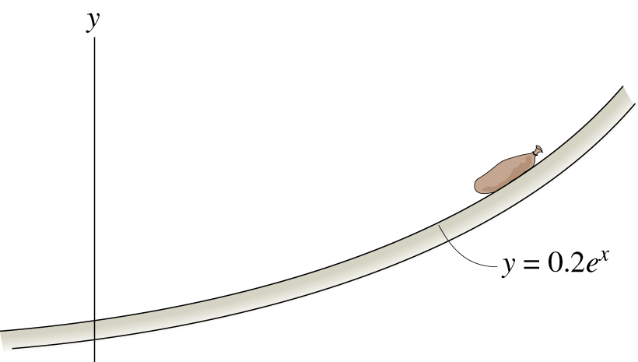
CONCEPT QUIZ
1. A 10 kg sack slides down a smooth surface. If the normal force at the flat spot on the surface, A, is 98.1 N (↑) , the radius of curvature is ____.
A) 0.2 m B) 0.4 m
C) 1.0 m D) None of the above.
v=2m/s
A
2. A 20 lb block is moving along a smooth surface. If the normal force on the surface at A is 10 lb, the velocity is ________.
A) 7.6 ft/s B) 9.6 ft/s
C) 10.6 ft/s D) 12.6 ft/s
A
ρ=7 ft
Notes:
Answers:
1. D
2. C

Slide 14
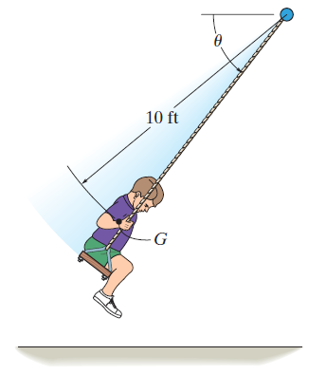
GROUP PROBLEM SOLVING I
Given: The boy has a weight of 60 lb. At the instant θ = 60, the boy’s center of mass G experiences a speed v = 15 ft/s.
Find: The tension in each of the two supporting cords of the swing and the rate of increase in his speed at this instant.
Plan:
1) Use n-t coordinates and treat the boy as a particle. Draw the free-body and kinetic diagrams.
2) Apply the equation of motion in the n-t directions.
Notes:
Source : P13-60

Slide 15
GROUP PROBLEM SOLVING I (continued)
Solution:
1) The n-t coordinate system can be established on the boy at angle 60°. Approximating the boy as a particle, the free-body and kinetic diagrams can be drawn:
Free-body diagram
Kinetic diagram
W
n
n
60°
2T
=
60°
ma_{n}
ma_{t}
t
t

Slide 16
GROUP PROBLEM SOLVING I (continued)
Free-body diagram
Kinetic diagram
W
n
n
60°
2T
=
60°
ma_{n}
ma_{t}
t
t
2) Apply the equations of motion in the n-t directions.
∑F_{n} = ma_{n} ⇒ 2T − W sin 60° = ma_{n}
Using a_{n} = v²/ρ = 15²/10, W = 60 lb,
we get: T = 46.9 lb
∑F_{t} = ma_{t} ⇒ 60 cos 60° = (60 / 32.2) a_{t}
.
a_{t} = v = 16.1 ft/s²

Slide 17
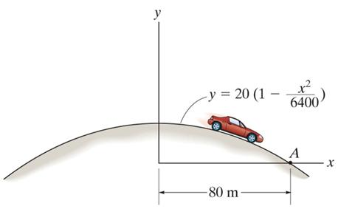
GROUP PROBLEM SOLVING II
Given: A 800 kg car is traveling over a hill with the shape of a parabola. When the car is at point A, its v = 9 m/s and a = 3 m/s². (Neglect the size of the car.)
Find: The resultant normal force and resultant frictional force exerted on the road at point A by the car.
Plan:
1) Treat the car as a particle. Draw its free-body and kinetic diagrams.
2) Apply the equations of motion in the n-t directions.
3) Use calculus to determine the slope and radius of curvature of the path at point A.
Notes:
Source : P13-69

Slide 18
GROUP PROBLEM SOLVING II (continued)
Solution:
1) The n-t coordinate system can be established on the car at point A. Treat the car as a particle and draw the free-body and kinetic diagrams:
W
F
θ
=
ma_{n}
ma_{t}
N
θ
n
t
n
t
W = mg = weight of car
N = resultant normal force on road
F = resultant friction force on road

Slide 19
GROUP PROBLEM SOLVING II (continued)
2) Apply the equations of motion in the n-t directions:
∑ F_{n} = ma_{n} ⇒ W cos θ – N = ma_{n}
Using W = mg and a_{n} = v²/ρ = (9)²/ρ
⇒ (800)(9.81) cos θ – N = (800) (81/ρ)
⇒ N = 7848 cos θ – 64800 / ρ Eq. (1)
∑ F_{t} = ma_{t} ⇒ W sin θ – F = ma_{t}
Using W = mg and a_{t} = 3 m/s² (given)
⇒ (800)(9.81) sin θ – F = (800) (3)
⇒ F = 7848 sin θ – 2400 Eq. (2)

Slide 20
GROUP PROBLEM SOLVING II (continued)
3) Determine ρ by differentiating y = f(x) at x = 80 m:
y = 20(1 – x²/6400) ⇒ dy/dx = (–40) x / 6400
⇒ d²y/dx² = (–40) / 6400
dy
dx
[1 + ( )²]^{3/2}
[1 + (–0.5)²]^{3/2}
0.00625
ρ = =
= 223.6 m
d²y
dx²
x = 80 m
Determine θ from the slope of the curve at A:
tan θ = dy/dx
θ = tan⁻¹ (dy/dx) = tan⁻¹ (-0.5) = 26.6°
dy
x = 80 m
θ
dx

Slide 21
GROUP PROBLEM SOLVING II (continued)
From Eq. (1): N = 7848 cos θ – 64800 / ρ
= 7848 cos (26.6°) – 64800 / 223.6 = 6728 N
From Eq. (2): F = 7848 sin θ – 2400
= 7848 sin (26.6°) – 2400 = 1114 N

Slide 22
ATTENTION QUIZ
1. The tangential acceleration of an object
A) represents the rate of change of the velocity vector’s direction.
B) represents the rate of change in the magnitude of the velocity.
C) is a function of the radius of curvature.
D) Both B and C.
2. The block has a mass of 20 kg and a speed of
v = 30 m/s at the instant it is at its lowest point. Determine the tension in the cord at this instant.
A) 1596 N B) 1796 N
C) 1996 N D) 2196 N
10 m
θ
v = 30m/s
Notes:
Answers:
1. B
2. C

Slide 23
End of the Lecture
Let Learning Continue

