Slide 1
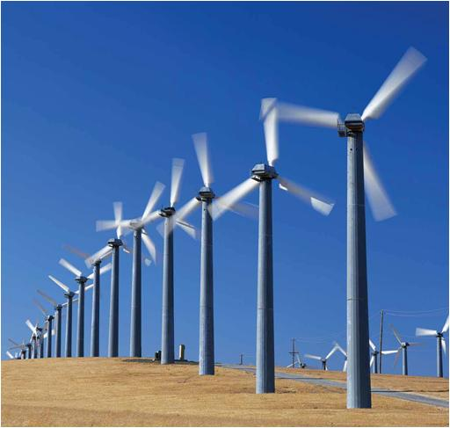
PLANAR RIGID BODY MOTION: TRANSLATION & ROTATION
Today’s Objectives :
Students will be able to:
Analyze the kinematics of a rigid body undergoing planar translation or rotation about a fixed axis.
In-Class Activities :
Check Homework
Reading Quiz
Applications
Types of Rigid-Body Motion
Planar Translation
Rotation about a Fixed Axis
Concept Quiz
Group Problem Solving
Attention Quiz

Slide 2
READING QUIZ
1. If a rigid body is in translation only, the velocity at points A and B on the rigid body _______ .
A) are usually different
B) are always the same
C) depend on their position
D) depend on their relative position
2. If a rigid body is rotating with a constant angular velocity about a fixed axis, the velocity vector at point P is _______.
A) ω × r_{p} B) r_{p}× ω
C) dr_{p}/dt D) All of the above.
Notes:
Answers:
1. B
A (should be w x r, not r x w)

Slide 3
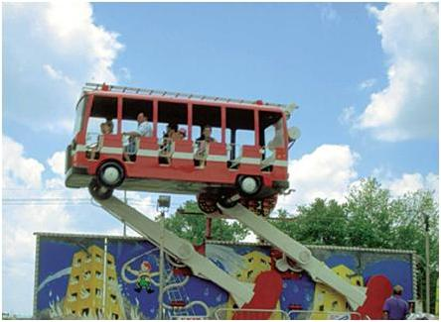
APPLICATIONS
Passengers on this amusement ride are subjected to curvilinear translation since the vehicle moves in a circular path but they always remains upright.
If the angular motion of the rotating arms is known, how can we determine the velocity and acceleration experienced by the passengers? Why would we want to know these values?
Does each passenger feel the same acceleration?

Slide 4
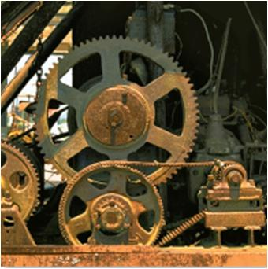
APPLICATIONS (continued)
Gears, pulleys and cams, which rotate about fixed axes, are often used in machinery to generate motion and transmit forces. The angular motion of these components must be understood to properly design the system.
To do this design, we need to relate the angular motions of contacting bodies that rotate about different fixed axes. How is this different than the analyses we did in earlier chapters?

Slide 5
RIGID BODY MOTION (Section 16.1)
There are cases where an object cannot be treated as a particle. In these cases the size or shape of the body must be considered. Rotation of the body about its center of mass requires a different approach.
For example, in the design of gears, cams, and links in machinery or mechanisms, rotation of the body is an important aspect in the analysis of motion.
We will now start to study rigid body motion. The analysis will be limited to planar motion.
A body is said to undergo planar motion when all parts of the body move along paths equidistant from a fixed plane.

Slide 6
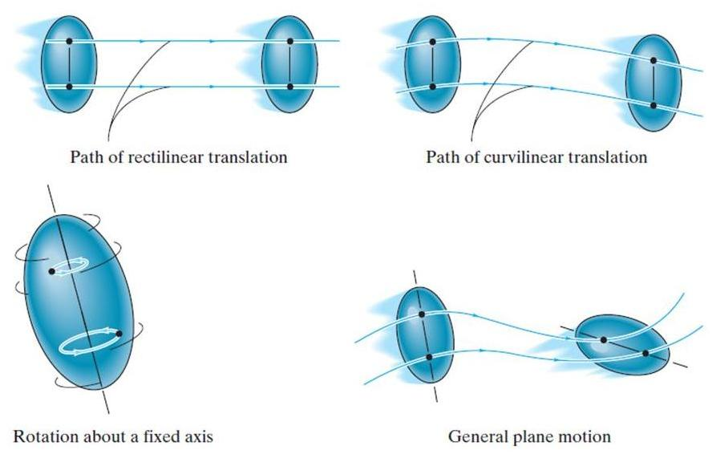
PLANAR RIGID BODY MOTION
There are three types of planar rigid body motion.
I
II
III

Slide 7
PLANAR RIGID BODY MOTION (continued)
Translation: Translation occurs if every line segment on the body remains parallel to its original direction during the motion. When all points move along straight lines, the motion is called rectilinear translation. When the paths of motion are curved lines, the motion is called curvilinear translation.

Slide 8
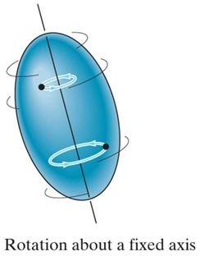
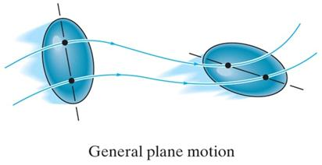
PLANAR RIGID BODY MOTION (continued)
Rotation about a fixed axis: In this case, all the particles of the body, except those on the axis of rotation, move along circular paths in planes perpendicular to the axis of rotation.
General plane motion: In this case, the body undergoes both translation and rotation. Translation occurs within a plane and rotation occurs about an axis perpendicular to this plane.

Slide 9
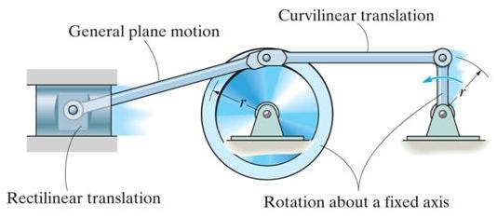
PLANAR RIGID BODY MOTION (continued)
An example of bodies undergoing the three types of motion is shown in this mechanism.
The wheel and crank undergo rotation about a fixed axis. In this case, both axes of rotation are at the location of the pins and perpendicular to the plane of the figure.
The piston undergoes rectilinear translation since it is constrained to slide in a straight line.
The connecting rod undergoes curvilinear translation, since it will remain horizontal as it moves along a circular path.
The connecting rod undergoes general plane motion, as it will both translate and rotate.

Slide 10
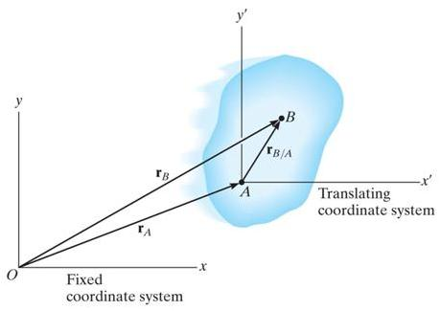
RIGID-BODY MOTION: TRANSLATION (Section 16.2)
The positions of two points A and B on a translating body can be related by
r_{B} = r_{A} + r_{B/A}
where r_{A} & r_{B} are the absolute position vectors defined from the fixed x-y coordinate system, and r_{B/A} is the relative-position vector between B and A.
The velocity at B is v_{B} = v_{A}+ dr_{B/A}/dt .
Now dr_{B/A}/dt = 0 since r_{B/A} is constant. So, v_{B} = v_{A}, and by following similar logic, a_{B} = a_{A}.
Note, all points in a rigid body subjected to translation move with the same velocity and acceleration.

Slide 11
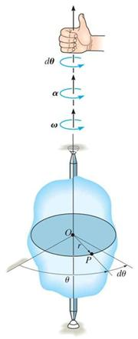
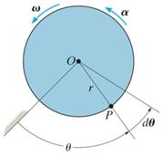
RIGID-BODY MOTION: ROTATION ABOUT A FIXED AXIS (Section 16.3)
When a body rotates about a fixed axis, any point P in the body travels along a circular path. The angular position of P is defined by θ.
The change in angular position, dθ, is called the angular displacement, with units of either radians or revolutions. They are related by
1 revolution = (2π) radians
Angular velocity, ω, is obtained by taking the time derivative of angular displacement:
ω = dθ/dt (rad/s) +
Similarly, angular acceleration is
α = d²θ/dt² = dω/dt or α = ω(dω/dθ) rad/s² +

Slide 12
RIGID-BODY MOTION: ROTATION ABOUT A FIXED AXIS (continued)
If the angular acceleration of the body is constant, α = α_{C,} the equations for angular velocity and acceleration can be integrated to yield the set of algebraic equations below.
ω = ω₀ + α_{C} t
θ = θ₀ + ω₀ t + 0.5 α_{C} t²
ω² = (ω₀)² + 2α_{C} (θ – θ₀)
θ₀ and ω₀ are the initial values of the body’s angular position and angular velocity. Note these equations are very similar to the constant acceleration relations developed for the rectilinear motion of a particle.

Slide 13
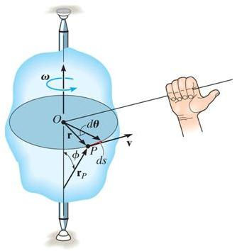
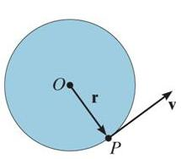
RIGID-BODY ROTATION: VELOCITY OF POINT P
The magnitude of the velocity of P is equal to ωr (the text provides the derivation). The velocity’s direction is tangent to the circular path of P.
In the vector formulation, the magnitude and direction of v can be determined from the cross product of ω and r_{p} . Here r_{p} is a vector from any point on the axis of rotation to P.
v = ω × r_{p} = ω × r
The direction of v is determined by the right-hand rule.

Slide 14
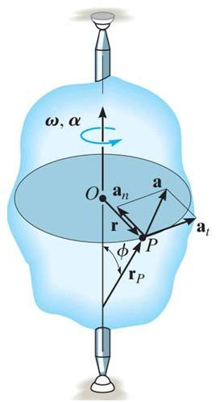
RIGID-BODY ROTATION: ACCELERATION OF POINT P
The acceleration of P is expressed in terms of its normal (a_{n}) and tangential (a_{t}) components.
In scalar form, these are a_{t} = α r and a_{n} = ω² r.
The tangential component, a_{t}, represents the time rate of change in the velocity's magnitude. It is directed tangent to the path of motion.
The normal component, a_{n}, represents the time rate of change in the velocity’s direction. It is directed toward the center of the circular path.

Slide 15
RIGID-BODY ROTATION: ACCELERATION OF POINT P (continued)
Using the vector formulation, the acceleration of P can also be defined by differentiating the velocity.
a = dv/dt = dω/dt × r_{P} + ω × dr_{P}/dt
= α × r_{P} + ω × (ω × r_{P})
It can be shown that this equation reduces to
a = α × r – ω²r = a_{t} + a_{n}
The magnitude of the acceleration vector is a=$\sqrt{{(a_{n})}^{2}+{(a_{t})}^{2}}$

Slide 16
ROTATION ABOUT A FIXED AXIS: PROCEDURE
• Establish a sign convention along the axis of rotation.
• If a relationship is known between any two of the variables (α, ω, θ, or t), the other variables can be determined from the equations: ω = dθ/dt α = dω/dt α dθ = ω dω
• If α is constant, use the equations for constant angular acceleration.
• To determine the motion of a point, the scalar equations v = ω r, a_{t} = α r, a_{n} = ω²r , and a =$\sqrt{{(a_{n})}^{2}+{(a_{t})}^{2}}$ can be used.
• Alternatively, the vector form of the equations can be used (with i, j, k components).
v = ω × r_{P} = ω × r
a = a_{t} + a_{n} = α × r_{P} + ω × (ω × r_{P}) = α × r – ω²r

Slide 17
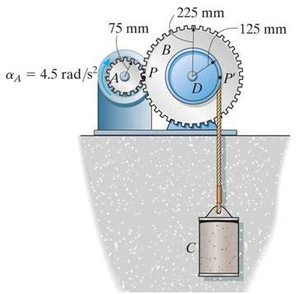
EXAMPLE
Given: The motor turns gear A with a constant angular acceleration, α_{A} = 4.5 rad/s², starting from rest. The cord is wrapped around pulley D which is rigidly attached to gear B.
Find: The velocity of cylinder C and
the distance it travels in 3 seconds.
Plan:
1) The angular acceleration of gear B (and pulley D) can be related to α_{A}.
2) The acceleration of cylinder C can be determined by using the equations of motion for a point on a rotating body since (a_{t})_{D} at point P is the same as a_{c}.
3) The velocity and distance of C can be found by using the constant acceleration equations.
Notes:
Source : F16-6

Slide 18
EXAMPLE (continued)
Solution:
1) Gear A and B will have the same speed and tangential component of acceleration at the point where they mesh. Thus,
a_{t} = α_{A} r_{A} = α_{B} r_{B} ⇒ (4.5)(75) = α_{B}(225) ⇒ α_{B} = 1.5 rad/s²
Since gear B and pulley D turn together, α_{D} = α_{B} = 1.5 rad/s²
2) Assuming the cord attached to pulley D is inextensible and does not slip, the velocity and acceleration of cylinder C will be the same as the velocity and tangential component of acceleration along the pulley D.
a_{C} = (a_{t})_{D} = α_{D} r_{D} = (1.5)(0.125) = 0.1875 m/s² ↑

Slide 19
EXAMPLE (continued)
3) Since α_{A} is constant, α_{D} and a_{C} will be constant. The constant acceleration equation for rectilinear motion can be used to determine the velocity and displacement of cylinder C when t = 3 s (s₀= v₀ = 0):
v_{c} = v₀ + a_{C} t = 0 + 0.1875 (3) = 0.563 m/s ↑
s_{c} = s₀ + v₀ t + (0.5) a_{C} t²
= 0 + 0 + (0.5) 0.1875 (3)² = 0.844 m ↑

Slide 20
CONCEPT QUIZ
y
1. A disk is rotating at 4 rad/s. If it is subjected to a constant angular acceleration of 2 rad/s², determine the acceleration at B.
A) (4 i + 32 j) ft/s² B) (4 i - 32 j) ft/s²
C) (- 4 i + 32 j) ft/s² D) (- 4 i -32 j) ft/s²
2 rad/s²
O
A
x
2 ft
B
2. A Frisbee is thrown and curves to the right. It is experiencing
A) rectilinear translation. B) curvilinear translation.
C) pure rotation. D) general plane motion.
Notes:
Answer:
1. C
2. D

Slide 21
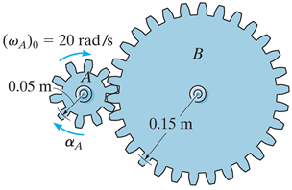
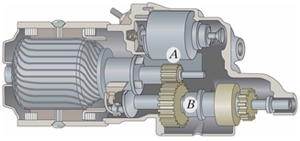
GROUP PROBLEM SOLVING
Given: Gear A is given an angular acceleration α_{A}= 4t³ rad/s², where t is in seconds, and (ω_{A})₀= 20 rad/s.
Find: The angular velocity and angular displacement of gear B when t = 2 s.
Plan:
1) Apply the kinematic equation of variable angular acceleration to find the angular velocity of gear A.
2) Find the relationship of angular motion between gear A and gear B in terms of time and then use 2 s.
Notes:
Source : P16-20

Slide 22
GROUP PROBLEM SOLVING (continued)
Solution:
1) Motion of Gear A : Applying the kinematic equation
$$\int_{ω_{A0}}^{ω_{A}}{dω_{A}}=\int_{0}^{t}{α_{A}dt}$$
$$ω_{A}−20=\int_{0}^{t}{\text{4}t^{3}dt}=t^{4} ⇒ ω_{A}=t^{4}+20$$
$$\int_{0}^{θ_{A}}{dθ_{A}}=\int_{0}^{t}{ω_{A}dt}$$
$$_{A}=\int_{0}^{t}{(t^{4}+20)dt}=\frac{1}{5}t^{5}+20 t$$
When t=2 s, $ω_{A}$= 36 rad/s and $_{A}$= 46.4 rad.

Slide 23
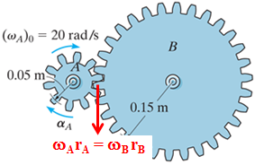
GROUP PROBLEM SOLVING (continued)
2) Since gear B meshes with gear A,
ω_{A} r_{A} = ω_{B} r_{B}
$$ ω_{B} = ω_{A} (r_{A} / r_{B}) = ω_{A} (0.05 / 0.15)
Similarly, θ_{B} = θ_{A} (0.05 / 0.15)
Since $ω_{A}$= 36 rad/s and $_{A}$= 46.4 rad at t=2 s,
ω_{B} = 36 (0.05 / 0.15) = 12 rad/s
θ_{B} = 46.4 (0.05 / 0.15) = 15.5 rad

Slide 24
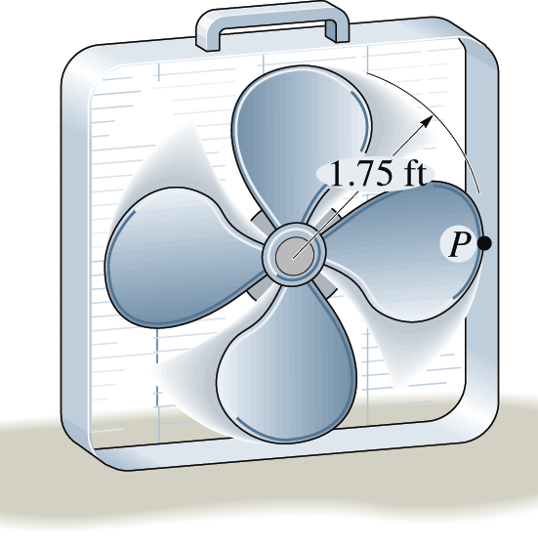
ATTENTION QUIZ
1. The fan blades suddenly experience an angular acceleration of 2 rad/s². If the blades are rotating with an initial angular velocity of 4 rad/s, determine the speed of point P when the blades have turned 2 revolutions
(when ω = 8.14 rad/s).
A) 14.2 ft/s B) 17.7 ft/s
C) 23.1 ft/s D) 26.7 ft/s
2. Determine the magnitude of the acceleration at P when the blades have turned the 2 revolutions.
A) 0 ft/s² B) 3.5 ft/s²
C) 115.95 ft/s² D) 116 ft/s²
Notes:
Answers:
1. A (using v=rw and the angular velocity provided)
2. D (Answer B is tangential acc. & C is the normal acc.)

Slide 25
End of the Lecture
Let Learning Continue

