Slide 1
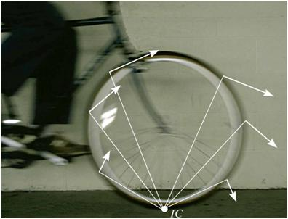
INSTANTANEOUS CENTER OF ZERO VELOCITY
Today’s Objectives:
Students will be able to:
Locate the instantaneous center of zero velocity.
Use the instantaneous center to determine the velocity of any point on a rigid body in general plane motion.
In-Class Activities:
Check Homework
Reading Quiz
Applications
Location of the Instantaneous Center
Velocity Analysis
Concept Quiz
Group Problem Solving
Attention Quiz

Slide 2
READING QUIZ
1. If applicable, the method of instantaneous center can be used to determine the __________ of any point on a rigid body.
A) velocity B) acceleration
C) velocity and acceleration D) force
2. The velocity of any point on a rigid body is __________ to the relative position vector extending from the IC to the point.
A) always parallel B) always perpendicular
C) in the opposite direction D) in the same direction
Notes:
Answers:
1. A
2. B

Slide 3
APPLICATIONS
The instantaneous center (IC) of zero velocity for this bicycle wheel is at the point in contact with ground. The velocity direction at any point on the rim is perpendicular to the line connecting the point to the IC.
Which point on the wheel has the maximum velocity?
Does a larger wheel mean the bike will go faster for the same rider effort in pedaling than a smaller wheel?

Slide 4
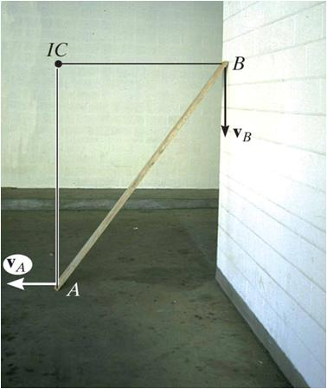
APPLICATIONS (continued)
As the board slides down the wall (to the left), it is subjected to general plane motion (both translation and rotation).
Since the directions of the velocities of ends A and B are known, the IC is located as shown.
How can this result help you analyze other situations?
What is the direction of the velocity of the center of gravity of the board?

Slide 5
INSTANTANEOUS CENTER OF ZERO VELOCITY (Section 16-6)
For any body undergoing planar motion, there always exists a point in the plane of motion at which the velocity is instantaneously zero (if it is rigidly connected to the body).
This point is called the instantaneous center (IC) of zero velocity. It may or may not lie on the body!
If the location of this point can be determined, the velocity analysis can be simplified because the body appears to rotate about this point at that instant.

Slide 6
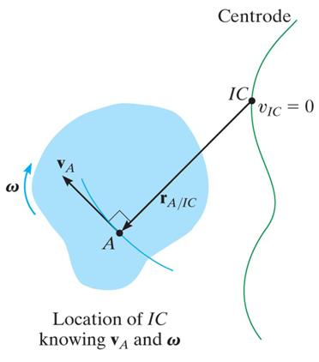
LOCATION OF THE INSTANTANEOUS CENTER
To locate the IC, we use the fact that the velocity of a point on a body is always perpendicular to the relative position vector from the IC to the point. Several possibilities exist.
First, consider the case when velocity v_{A} of a point A on the body and the angular velocity ω of the body are known.
In this case, the IC is located along the line drawn perpendicular to v_{A} at A, a distance r_{A/IC} = v_{A}/ω from A.
Note that the IC lies up and to the right of A since v_{A} must cause a clockwise angular velocity ω about the IC.

Slide 7
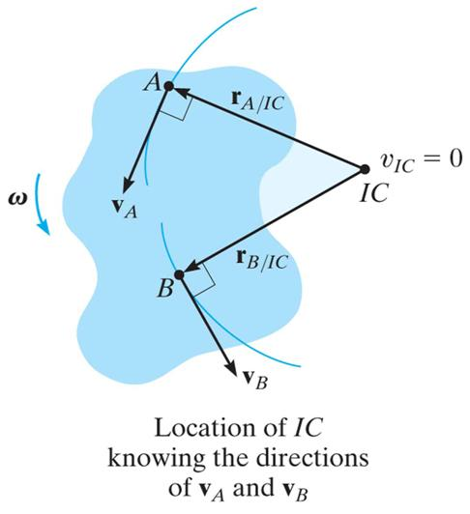
LOCATION OF THE INSTANTANEOUS CENTER (continued)
A second case occurs when the lines of action of two non-parallel velocities, v_{A} and v_{B}, are known.
First, construct line segments from A and B perpendicular to v_{A} and v_{B}. The point of intersection of these two line segments locates the IC of the body.

Slide 8
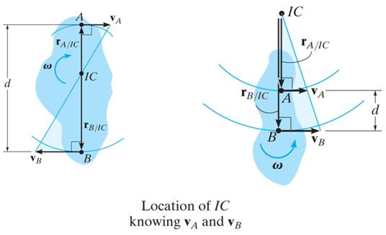
LOCATION OF THE INSTANTANEOUS CENTER (continued)
A third case is when the magnitude and direction of two parallel velocities at A and B are known. Here the location of the IC is determined by proportional triangles.
As a special case, note that if the body is translating only (v_{A} = v_{B}), then the IC would be located at infinity. Then ω equals zero, as expected.

Slide 9
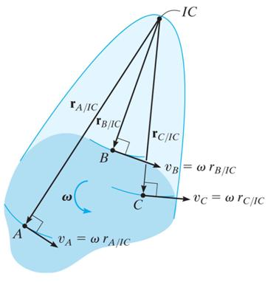
VELOCITY ANALYSIS
The velocity of any point on a body undergoing general plane motion can be determined easily, often with a scalar approach, once the instantaneous center of zero velocity of the body is located.
Since the body seems to rotate about the IC at any instant, as shown in this kinematic diagram, the magnitude of velocity of any arbitrary point is v = ω r, where r is the radial distance from the IC to the point.
The velocity’s line of action is perpendicular to its associated radial line.

Slide 10
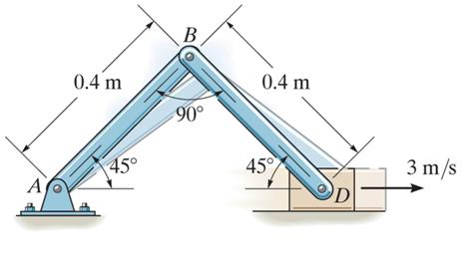
EXAMPLE I
Given: A linkage undergoing motion as shown. The velocity of the block, v_{D}, is 3 m/s.
Find: The angular velocities of links AB and BD.
Plan:
Locate the instantaneous center of zero velocity of link BD and then solve for the angular velocities.
Notes:
Source : Example 16.10

Slide 11
EXAMPLE I (continued)
Solution: Since D moves to the right, it causes link AB to rotate clockwise about point A. The instantaneous center of velocity for BD is located at the intersection of the line segments drawn perpendicular to v_{B} and v_{D}. Note that v_{B} is perpendicular to link AB. Therefore we can see that the IC is located along the extension of link AB.
Notes:
11

Slide 12
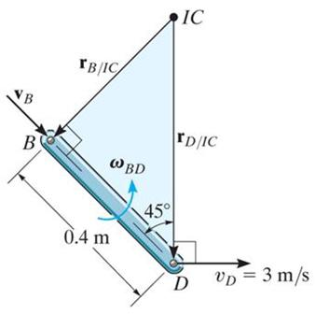
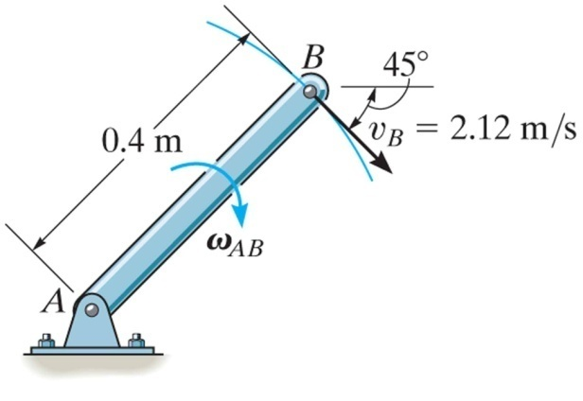
EXAMPLE I (continued)
Using these facts,
r_{B/IC} = 0.4 tan 45° = 0.4 m
r_{D/IC} = 0.4/cos 45° = 0.566 m
Since the magnitude of v_{D} is known, the angular velocity of link BD can be found from v_{D} = ω_{BD} r_{D/IC} .
ω_{BD} = v_{D}/r_{D/IC} = 3/0.566 = 5.3 rad/s
Link AB is subjected to rotation about A.
ω_{AB} = v_{B}/r_{B/A} = (r_{B/IC})ω_{BD}/r_{B/A} = 0.4(5.3)/0.4 = 5.3 rad/s

Slide 13
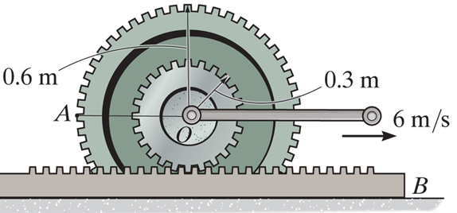
EXAMPLE II
Given: The center O of the gear set rolls with v_{O} = 6 m/s. The gear rack B is fixed.
Find: The velocity of point A on the outer gear.
Plan:
Locate the IC of the smaller gear. Then calculate the velocities at A.
Notes:
Source : F16-15

Slide 14
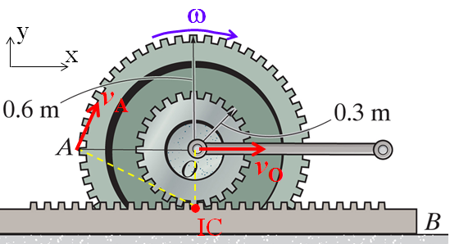
EXAMPLE II (continued)
Solution:
Note that the gear rolls without slipping. Thus, the IC is at the contact point with the gear rack B.
The angular velocity of the wheel can be found from
ω = v_{O}/r_{O/IC} = 6/0.3 = 20 rad/s ( or CW)
The velocity at A will be
v_{A} = ω × r_{A/IC} = (−20 ) k × ($−$0.6 i + 0.3j) = (6 i + 12 j) m/s
v_{A} = $\sqrt{6^{2}+{12}^{2}}$ = 13.4 m/s
θ = tan⁻¹(12/6) = 63.4°
θ

Slide 15
CONCEPT QUIZ
1. When the velocities of two points on a body are equal in magnitude and parallel but in opposite directions, the IC is located at
A) infinity.
B) one of the two points.
C) the midpoint of the line connecting the two points.
D) None of the above.
2. When the direction of velocities of two points on a body are perpendicular to each other, the IC is located at
A) infinity.
B) one of the two points.
C) the midpoint of the line connecting the two points.
D) None of the above.
Notes:
Answers:
C
D

Slide 16
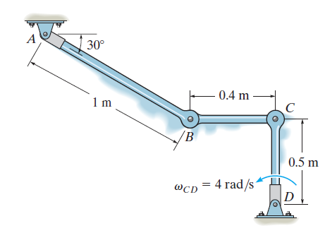
GROUP PROBLEM SOLVING
Given: Rod CD is rotating with an angular velocity ω_{CD} = 4 rad/s CCW.
Find: The angular velocities of rods AB and BC.
Plan:
This is an example of the second case in the lecture notes. Since the direction of Point B’s velocity must be perpendicular to AB, and Point C’s velocity must be perpendicular to CD, the location of the instantaneous center, I, for link BC can be found.
Notes:
Source : P16-87

Slide 17
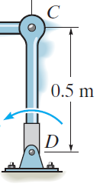
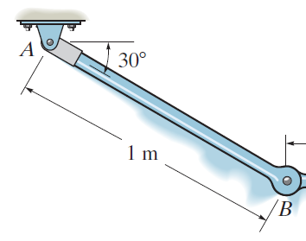
GROUP PROBLEM SOLVING (continued)
Solution:
Draw kinematic diagrams for Link CD and Link AB:
Link CD:
Link AB:
v_{C}
ω_{AB}
r_{CD}
ω_{CD} = 4 rad/s
r_{AB}
v_{B}
v_{C} = ω_{CD} (r_{CD})
= 4 (0.5)
= 2 m/s
v_{B} = ω_{AB} (r_{AB}) m/s

Slide 18
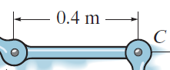
GROUP PROBLEM SOLVING (continued)
With the results of v_{B} and v_{C}, the IC for link BC can be located.
Kinematic diagram for Link BC:
r_{C/IC} = (0.4) tan30° r_{C/IC} = 0.2309 m
r_{B/IC} = 0.4 / cos30° r_{B/IC} = 0.4619 m
v_{C}
ω_{BC}
v_{B}
r_{B/IC}
r_{C/IC}
30°
•
IC
Then, the kinematics gives:
v_{C} = ω_{BC} (r_{C/IC}) ⇒ 2.0 = ω_{BC} (0.2309 )
ω_{BC} = 8.66 rad/s
v_{B} = ω_{BC} (r_{B/IC}) = ω_{AB} (r_{AB}) ⇒ 8.66 (0.4619 ) = ω_{AB} (1)
ω_{AB} = 4.0 rad/s

Slide 19
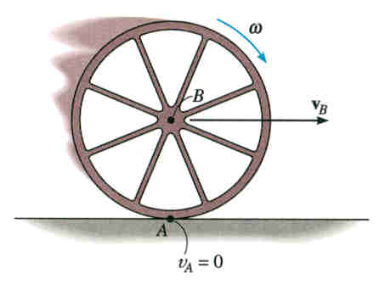
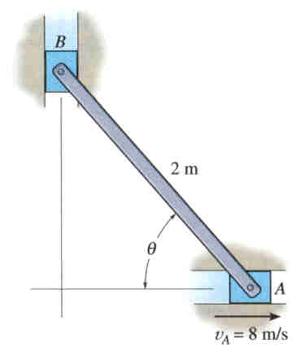
ATTENTION QUIZ
1. The wheel shown has a radius of 15 in and rotates clockwise at a rate of ω = 3 rad/s. What is v_{B}?
A) 5 in/s B) 15 in/s
C) 0 in/s D) 45 in/s
2. Point A on the rod has a velocity of 8 m/s to the right. Where is the IC for the rod?
A) Point A.
B) Point B.
C) Point C.
D) Point D.
• C
D •
Notes:
Answers:
1. D
2. C

Slide 20
End of the Lecture
Let Learning Continue

